Slide 1
bwya
JOB,
VICTIM
TO
VICTOR,

Slide 2
bwya
INTRODUCTION TO THE BOOK OF JOB
Course Title: Job, Victim to Victor
Dates: March 5 through 28 May
Introduction of Instructors:
Deacon Joseph Moss and Dr Gary Huckabay
Course Objective:
To address 10 major themes and issues in the book of Job that have practical application for today’s Christian and dispel a commonly held concept that Job teaches us to be more suffering victims than courageous victors.
JOB

Slide 3
bwya
INTRODUCTION TO THE BOOK OF JOB
References and Participant Resources
References: We have provided an annotated bibliography. This does not include all the resources consulted like references included in BibleWorks and Olive Tree, etc.
Participant resources: some background information and a theological summary; a brief annotated outline of Job; and character sketches of the major personalities.
About the Title of the Course
“Victim to Victory” – What does that mean?
Victim to victory stories: those will be engaging pericopes at the beginning of each lesson with little pizzaz and maybe a surprise or two.
JOB

Slide 4
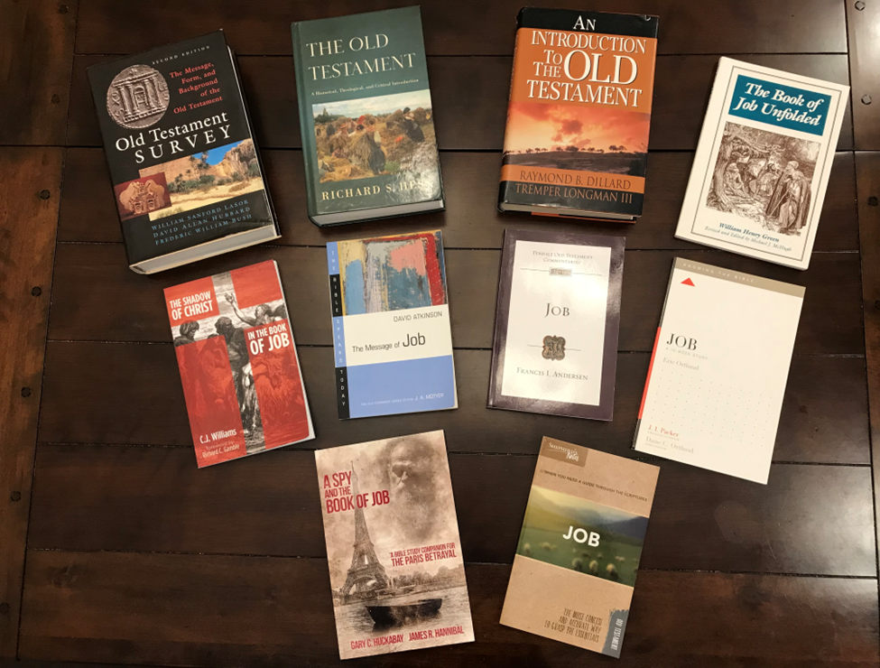
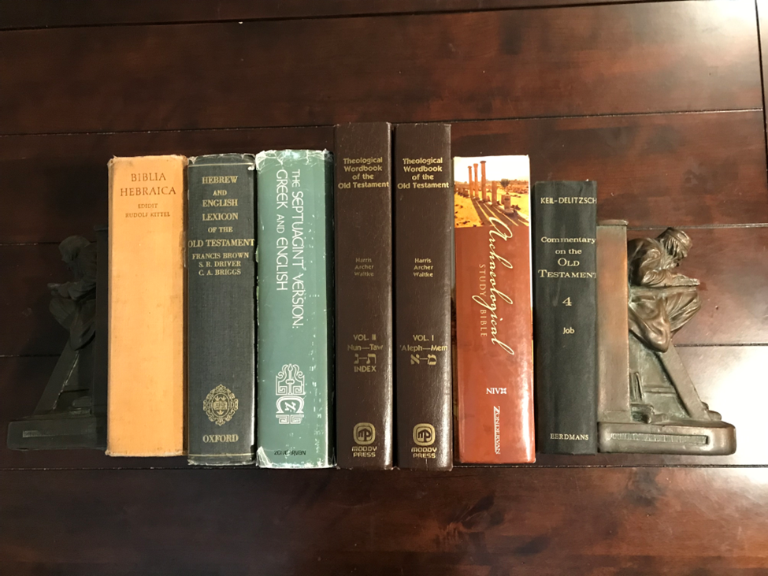
References

Slide 5
bwya
INTRODUCTION TO THE BOOK OF JOB
References and Participant Resources
References: We have provided an annotated bibliography. This does not include all the resources consulted like references included in BibleWorks and Olive Tree, etc.
Participant resources: some background information and a theological summary; a brief annotated outline of Job; and character sketches of the major personalities.
About the Title of the Course
“Victim to Victory” – What does that mean?
Victim to victory stories: those will be engaging pericopes at the beginning of each lesson with little pizzaz and maybe a surprise or two.
JOB

Slide 6
bwya
INTRODUCTION TO THE BOOK OF JOB
A Word about the Thematic Approach
By thematic approach we mean that instead of a verse by verse (exegetical) approach we chose to select common verses from various speeches and tie them together in a theme – 10 themes
The10 themes: The Role of the Adversary, Perspectives on God in Job; Perspectives on Job’s Innocence; Perspectives on Suffering in Job; Perspectives on Faith in Job; Perspectives on Justice in Job; Perspectives on Sin in Job; Perspectives on Job as a Type of Christ; Perspectives on Life in Job; Perspectives on Wisdom in Job; Lessons from Job for Today.
JOB

Slide 7
bwya
INTRODUCTION: CLASS FORMAT
Note: the Michael Card music in the background relates to our theme called, “A Job Suite”
I. Victim to Victory Story (Modern Era Jobs)
II. Introduction to the Theme
A. Definition of the Theme
Participant Expectations
III. Perspectives on the Theme
A. Key references for the Theme
B. Complicating cultural influences
Teachings from Job on the Theme
IV. Engagement Questions and Closing Applications
JOB

Slide 8
bwya
INTRODUCTION: Background to Job
Background to the Book of Job
Historical period
Location – Uz (pronounced “oots”)
We do not know where Uz/Uts was but see Gen 36:28, Jer 25:20, and Lam 4:21 for hints.
Map
JOB

Slide 9
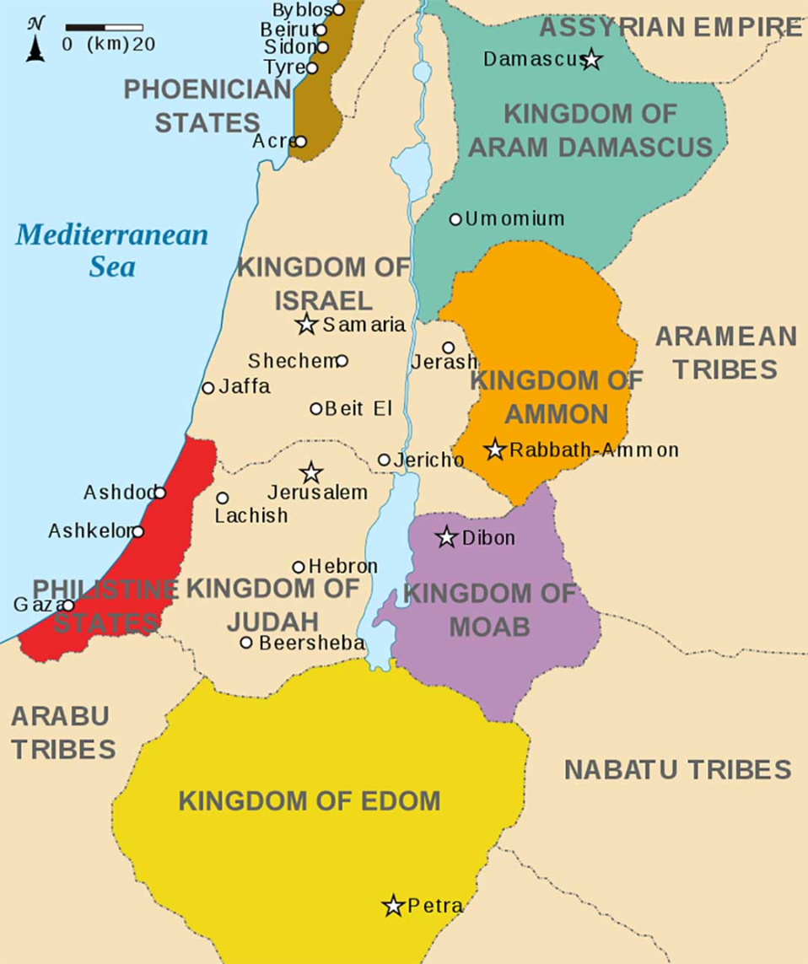
Location of Uz?

Slide 10
bwya
INTRODUCTION: Background to Job
Literary background
Placement in the biblical context
Wisdom literature
Combination of narrative and poetry
Authorship (not Moses)
Influence of other ancient texts
Personalities (see list of character sketches provided)
JOB

Slide 11
bwya
INTRODUCTION: SETTING THE STAGE
Setting the Stage (Chs 1-2)
Narrative introduction
Job the Prosperous
Job the Righteous
Job the Unknowing Target
Job the Victim
JOB

Slide 12
bwya
INTRODUCTION: APPLICATION
Application Questions:
Can you name some biblical personalities, other than Jesus, who were righteous “victims” and “victors”? Justify your choices.
How would you characterize the “friends” of Job at this point?
JOB

Slide 13
bwya
JOB,
VICTIM
TO
VICTOR,

