Slide 1
JOB, VICTIM TO VICTOR The Role of the Adversary

Slide 2
JOB: Victim to Victory
A Story of an Oppressed People
VICTORY
VICTIM
OR

Slide 3
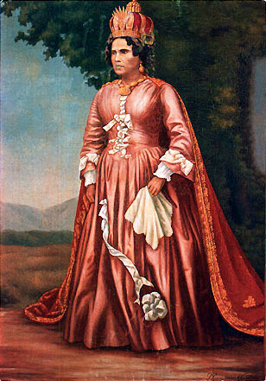
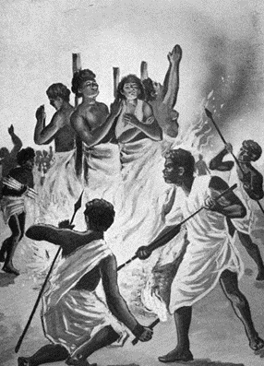
The Story of an Oppressed People
VICTIM
VICTORY
OR

Slide 4
JOB: Victim to Victory
II. Introduction to the Theme
Definition of the theme
Role: a person’s (or being’s) expected functions, activities, and actions
The role and person of HaSatan is in his names: like the Adversary or Antagonist
He is known as the Accuser and Slanderer
He is also Abaddon/Apollyon, the afflicter and destroyer
He is also the Tempter
VICTORY
VICTIM
OR

Slide 5
JOB: Victim or Victory
II. Introduction to the Theme
Definition (functions as the adversary, antagonist, accuser, afflicter and tempter)
Participant Expectations
What issues do you expect to be addressed?
What have you always wanted to know?
VICTORY
VICTIM
OR

Slide 6
JOB: INTRODUCTION (continued)
III. Perspectives on the Theme
Key References
Job 1-2; 42 (Adversary, Antagonist, Accuser, Afflicter, Tempter, Loser)
Job 2:9 (the temptress)
Job 4:8,27; 8:11; 11:5-6, 33:9,12 (the earthly accusers)
Gen 3; Matt 4:1 (Tempter)
VICTORY
VICTIM
OR

Slide 7
JOB: INTRODUCTION (continued)
III. Perspectives on the Theme
Key References (continued)
5. Zech 3:1-2 (Accuser)
6. Luke 22:31 (Afflicter)
7. II Cor 11:14 (angel of light)
8. I Pet 5:8 (Slanderer, Antagonist)
9. Rev 9:11; 12:3,7-9 (Destroyer)
VICTORY
VICTIM
OR

Slide 8
JOB: INTRODUCTION (continued)
III. Perspectives on the Theme
B. Complicating Cultural Influences
How is the Adversary portrayed today?
How does our culture generally characterize him?
Here are three examples of contemporary cultural influence
VICTORY
VICTIM
OR

Slide 9
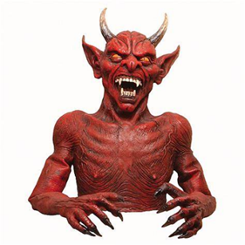
Images of the Adversary

Slide 10
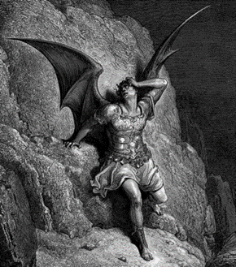
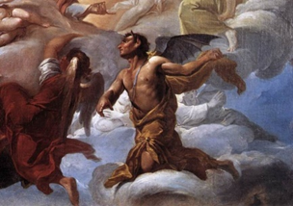
Images of the Adversary

Slide 11
Images of the Adversary

Slide 12
Images of the Adversary

Slide 13
Images of the Adversary

Slide 14
Images of the Adversary

Slide 15
JOB: INTRODUCTION (continued)
III. Perspectives on the Theme
B. Complicating Cultural Influences
How is the Adversary viewed today?
How do we portray him?
Here are three examples of contemporary cultural influence
VICTORY
VICTIM
OR

Slide 16
Johnny Blaze

Slide 17
Lucifer

Slide 18
FRANK E. PERETTI

Slide 19
JOB: Victim to Victory
III. Perspectives on the Theme
C. Teachings from Job on the Theme
The story of Job does not teach dualism
Job and Jesus show us that the Adversary is our adversary (Luke 22:31)
Job's saga reveals the Adversary as an influencer seeking opportunities to temp us to turn our backs on God
Job’s friends and wife teach us that we must not become allies of the Accuser and Tempter
VICTORY
VICTIM
OR

Slide 20
JOB: Victim to Victory
IV. Questions and Applications
What do you think was the purpose of the Adversary in coming before God?
How do we know when it’s the affliction of the Adversary and not God?
What does the Bible teach us about responding to affliction?
Why doesn’t the Adversary appear at the end of the book?
VICTORY
VICTIM
OR

